Slide 1

Rootfinding

Slide 2
Root Finding Problems
Many problems in Science and Engineering are expressed as:
These problems are called root finding problems.

Slide 3
Roots of Equations
A number r that satisfies an equation is called a root of the equation.

Slide 4
Zeros of a Function
Let f(x) be a real-valued function of a real variable.
Any number r for which f(r)=0 is called a zero of the function.
Examples:
2 and 3 are zeros of the function f(x) = (x-2)(x-3).

Slide 5
Graphical Interpretation of Zeros
The real zeros of a function f(x) are the values of x at which the graph of the function crosses (or touches) the x-axis.
f(x)
x₀
x₁
x₂
Real zeros of f(x)

Slide 6
Simple Zeros

Slide 7
Multiple Zeros

Slide 8
Multiple Zeros

Slide 9
Roots of Equations & Zeros of Function

Slide 10
Solution Methods
Several ways to solve nonlinear equations are possible:
Analytical Solutions
Possible for special equations only
Graphical Solutions
Useful for providing initial guesses for other methods
Numerical Solutions
Open methods
Bracketing methods

Slide 11
Analytical Methods
Analytical Solutions are available for special equations only.

Slide 12
Graphical Methods
Graphical methods are useful to provide an initial guess to be used by other methods.
Root
2
1
1 2

Slide 13
Numerical Methods
Many methods are available to solve nonlinear equations:
Bisection Method
Newton’s Method
Secant Method
False position Method
Muller’s Method
Bairstow’s Method
Fixed point iterations
……….

Slide 14
Bracketing Methods
In bracketing methods, the method starts with an interval that contains the root and a procedure is used to obtain a smaller interval containing the root.
Examples of bracketing methods:
Bisection method
False position method

Slide 15
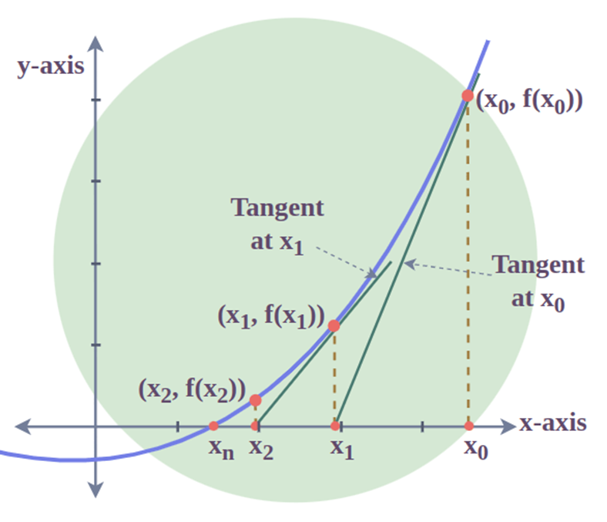
Open Methods
In the open methods, the method starts with one or more initial guess points. In each iteration, a new guess of the root is obtained.
Open methods are usually more efficient than bracketing methods.
They may not converge to a root.
new guess
initial guess

Slide 16
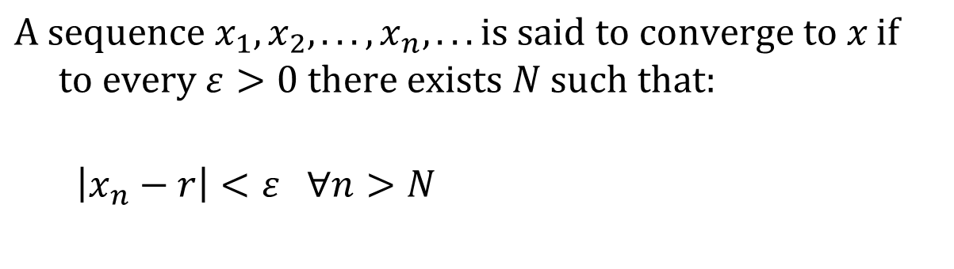
Convergence Notation
$$\text{A} \text{sequence} x_{1},x_{2},...,x_{n},...\text{is} \text{said} \text{to} converge \text{to} x \text{if} \\ \text{to} \text{every} ε>0 \text{there} \text{exists} N \text{such} \text{that}:$$ $$\left|x_{n}−r\right|<ε ∀n>N$$
Tolerance (max error)

Slide 17
Order of Convergence
with “k” a positive constant, then we say the root-finding numerical method is of order “p”. Larger values of “p” correspond to faster convergence to the root.
The order of convergence of bisection is one: the error is reduced by approximately a factor of 2 with each iteration so that

Slide 18
Speed of Convergence
Bisection Method:
Newton Method:
Secant Method:

Slide 19
Bisection Method

Slide 20
Introduction
The Bisection method is one of the simplest methods to find a zero of a nonlinear function.
It is also called interval halving method.
To use the Bisection method, one needs an initial interval that is known to contain a zero of the function.
The method systematically reduces the interval. It does this by dividing the interval into two equal parts. Then, performs a simple test and based on the result of the test, half of the interval is thrown away.
zero
b0
a0
a1
a₂

Slide 21
Intermediate Value Theorem
Let f(x) be defined on the interval [a,b].
Intermediate value theorem:
if a function is continuous and f(a) and f(b) have different signs then the function has at least one zero in the interval [a,b].
f(a)
a
b
f(b)

Slide 22
Examples
If f(a) and f(b) have the same sign, the function may have an even number of real zeros or no real zeros in the interval [a, b].
Bisection method can not be used in these cases.
a
b
The function has four real zeros
a
b
The function has no real zeros

Slide 23
Two More Examples
If f(a) and f(b) have different signs, the function has at least one real zero.
Bisection method can be used to find one of the zeros.
a
b
The function has one real zero
a
b
The function has three real zeros
Notes:
Convert to Speech:
if the function is continuous and ef of ay and ef of be have different signs then the functions has at least one zero and the Bisection method can be applied to find a zero of the function.

Slide 24
Bisection Method
Assumptions:
Given an interval [a,b]
f(x) is continuous on [a,b]
f(a) and f(b) have opposite signs.
These assumptions ensure the existence of at least one zero in the interval [a,b] and the bisection method can be used to obtain a smaller interval that contains the zero.
Notes:
Convert to Speech:
The assumptions are:
Given an interval ae be
The function is continuous on the interal
And the values of ef of a and ef of be have different signs.
These assumptions ensures the existence of at least one zero in the interval [a,b] and the bisection method can be used to obtain a smaller interval that contains the zero.

Slide 25
Bisection Algorithm
Assumptions:
f(x) is continuous on [a,b]
f(a) f(b) < 0
Algorithm:
Loop
1. Compute the mid point c=(a+b)/2
2. Evaluate f(c)
3. If f(a) f(c) < 0 then new interval [a, c]
If f(b) f(c) < 0 then new interval [c, b]
End loop
f(a)
c
b
a
f(b)
Notes:
Convert to Speech:
Assuming that the function is continuous on ay be and ef of ay times ef of be is negative. The Bisection algorithm is an iterative procedure that obtains a new interval that is guaranteed to contain a zero of the function.
In each iteration, the first step is to obtain the middle point in the interval then evaluate the function at the mid point. In the third step the new interval is obtained based on the sign of ef of ay times ef of see. If this product is negative then the new interval is ay see otherwise the new interval is ay be.
And the procedure is repeated

Slide 26
Example
Answer:
Notes:
Convert to Speech:
Can you use bisection method to find a zero of the function
Ex cube minus three x plus one over the interval zero to one.
Answer:
Ef of ex is a polynomial therefore it is continuous. Ef of zero times ef of 1 is equal to minus one.
All assumptions are satisfied and there fore we can use the bisection method.

Slide 27
Stopping Criteria
Two common stopping criteria
Stop after a fixed number of iterations
Stop when the absolute error is less than a specified value
How are these criteria related?
Notes:
Convert to Speech:
Two commonly used way to stop the Bisection method.
Stop after a given fixed number of iterations
Or
Stop when the error is less than a specified value.
In fact if one is given the initial interval and the error level, the number of iterations needed to achieve this accuracy can be calculated easily. Similarly if the initial interval and the number of iterations are given then one can obtain an upper bound on the resulted error.

Slide 28
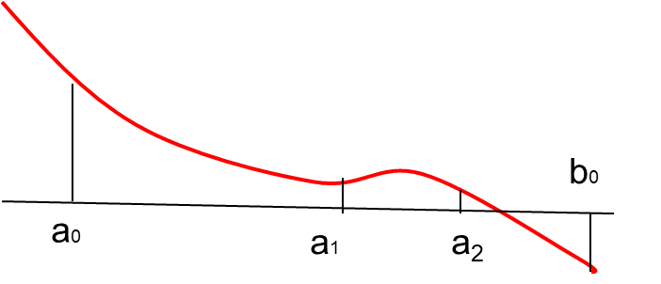
Stopping Criteria
(b-a)/4
(b-a)/2
Notes:
The above criteria are related. Fixing the number of iteration, you can get a formula relating the error to the number of iterations.
Let c en be the midpoint of the interval after n iterations and let r be the zero of the function
The error after n iterations is less than b minus a over two to the power n.

Slide 29
Convergence Analysis
ε
Notes:
Given ef of x , a, b and epsilon
We need to determine the number of iterations such that the absolute of r minus x is less than epsilon.
R here is the zero of the function and x is the bisection estimate. That is x equals see kay
The number of iterations n is given by the equation
N is greater than or equal to log of b minus a minus log of epsilon all over log of two.

Slide 30
Convergence Analysis – Alternative Form
Notes:
An alternative formula is given here
The number of iterations is greater than or equal to log to base two of the ratio of the width of the initial interval to the desired error.

Slide 31
Example
Notes:
In this example the formula for the number of iterations is used to answer the question
How many iterations of the bisection method is needed so that the error is less than epsilon
Here ay is 6, bee is 7 and epsilon is 0.0005
Direct substitution results in the inequality n must be greater than or equal to eleven.

Slide 32
Example
Use Bisection method to find a root of the equation x = cos (x) with absolute error <0.02
(assume the initial interval [0.5, 0.9])
Question 1: What is f (x) ?
Question 2: Are the assumptions satisfied ?
Question 3: How many iterations are needed ?
Question 4: How to compute the new estimate ?
Notes:
to solve this problem we need to answer four questions
What is f (x) in case it is not available directly.
Are the assumptions satisfied ?
How many iterations are needed to achieve the desired accuracy?
And finally
How to compute the new estimate ?

Slide 33
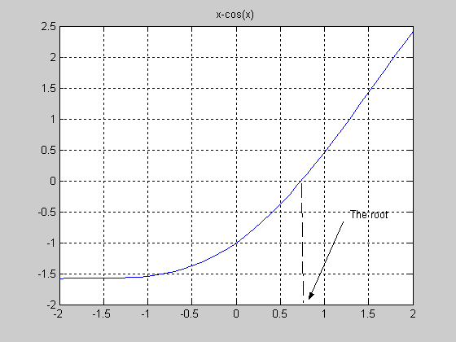
Notes:
This graph shows a plot of the function x minus cosine ex
The zero of the function is approximatley zero point seven and the interval zero pont five to zero point nine contains the zero for sure.

Slide 34
Bisection Method Initial Interval
f(a)=-0.3776 f(b) =0.2784
Error < 0.2
a =0.5 c= 0.7 b= 0.9

Slide 35
Bisection Method
-0.3776 -0.0648 0.2784
Error < 0.1
0.5 0.7 0.9
-0.0648 0.1033 0.2784
Error < 0.05
0.7 0.8 0.9

Slide 36
Bisection Method
-0.0648 0.0183 0.1033
Error < 0.025
0.7 0.75 0.8
-0.0648 -0.0235 0.0183
Error < .0125
0.70 0.725 0.75
Initial interval containing the root: [0.5,0.9]
After 5 iterations:
Interval containing the root: [0.725, 0.75]
Best estimate of the root is 0.7375
| Error | < 0.0125

Slide 37
Bisection Method
Advantages
Simple and easy to implement
One function evaluation per iteration
The size of the interval containing the zero is reduced by 50% after each iteration
The number of iterations can be determined a priori
No knowledge of the derivative is needed
The function does not have to be differentiable
Disadvantage
Slow to converge
Good intermediate approximations may be discarded

Slide 38
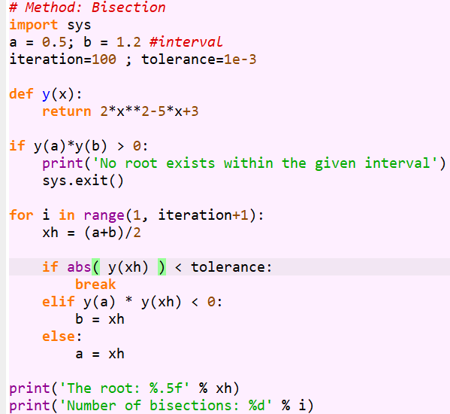
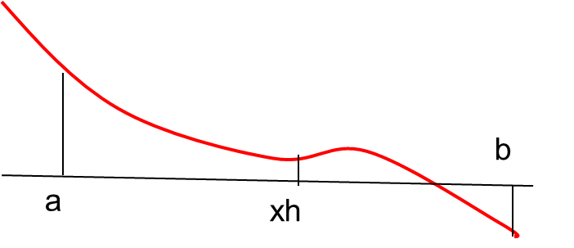
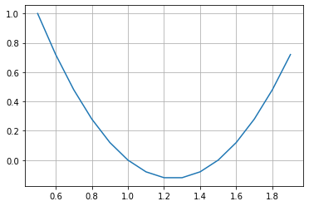


Slide 39
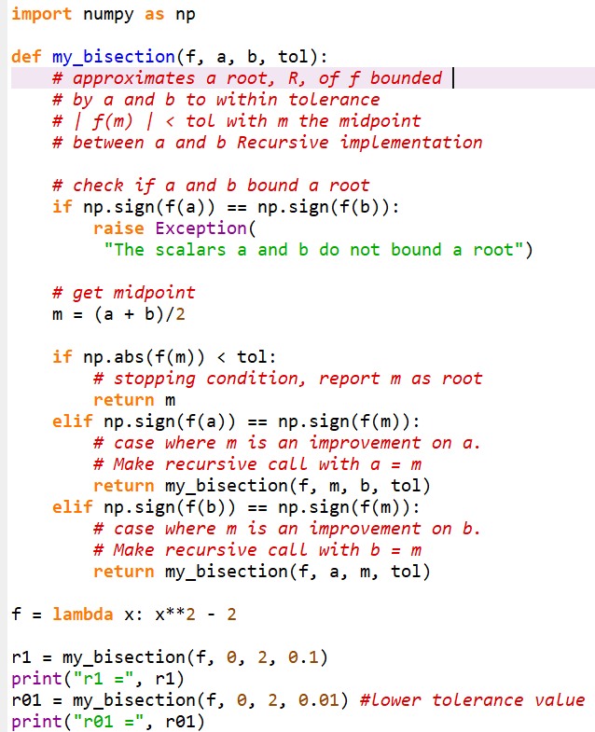


b
a
m

Slide 40
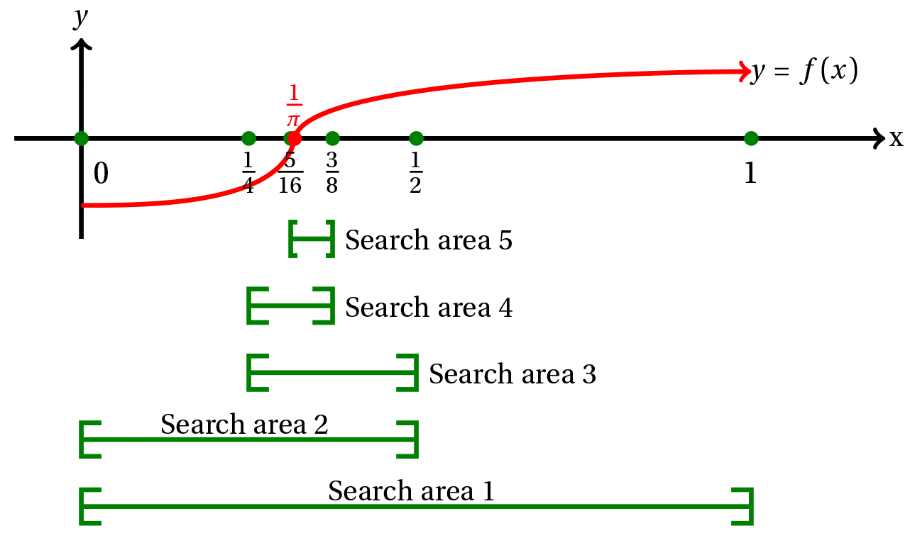
It is obvious that proceeding in this way will give a smaller and smaller intervals in which the root must lie.
But can we do better than this rather laborious bisection procedure?
In fact there are many ways to improve this numerical search for the root. In this Section we examine one of the best methods: the Newton-Raphson method.

Slide 41
Newton-Raphson Method

Slide 42
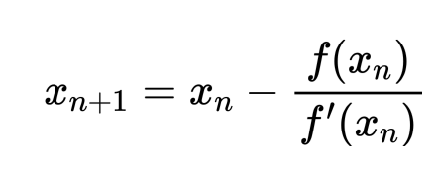
Newton-Raphson Method (Also known as Newton’s Method)
Given an initial guess of the root x₀, Newton-Raphson method uses information about the function and its derivative at that point to find a better guess of the root.
Assumptions:
f(x) is continuous and the first derivative is known
An initial guess x₀ such that f’(x₀)≠0 is given

Slide 43
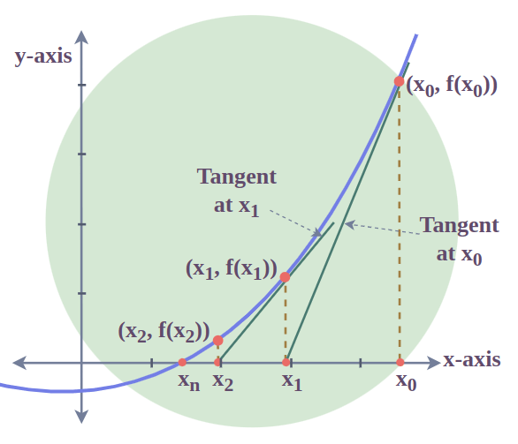
Newton-Raphson Method
If we draw the tangent to the curve at x0, this tangent will intersect the x-axis at a point closer to root than x0.
root
After 1st iteration
initial guess

Slide 44
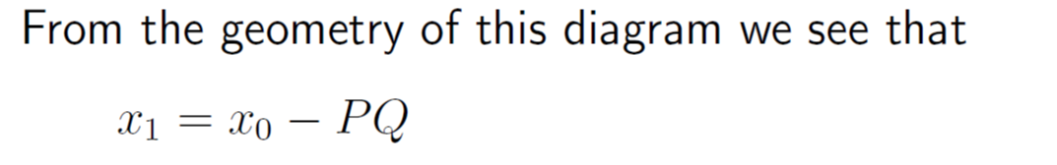
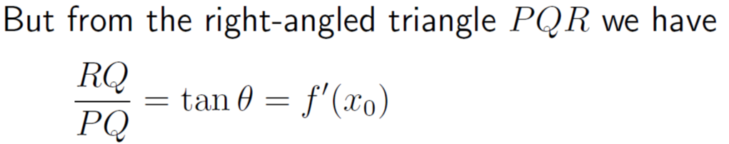
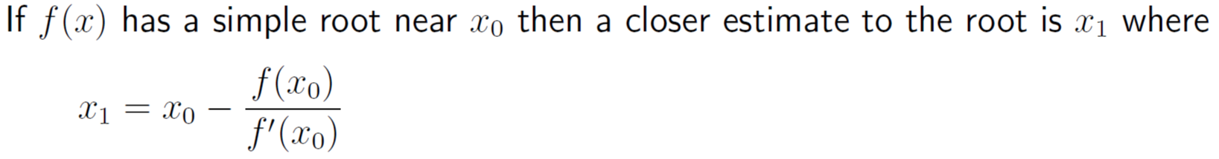
Newton-Raphson Method

Slide 45
Newton-Raphson Method

Slide 46
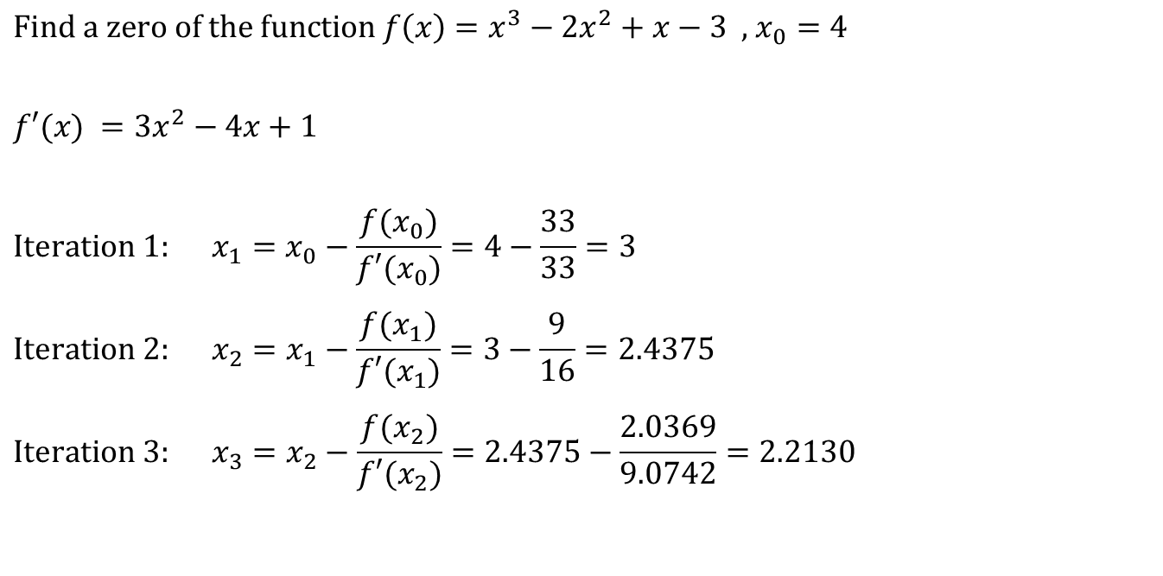
Example
initial guess
$$\text{Find} \text{a} \text{zero} \text{of} \text{the} \text{function} f\left(x\right)=x^{3}−2x^{2}+x−3\text{ , }x_{0}=\text{4}$$
$$f′(x) =3x^{2}−4x+1$$
$$\text{Iteration}\text{ 1: } x_{1}=x_{0}−\frac{f(x_{0})}{f′(x_{0})}=4−\frac{33}{33}=3$$
$$\text{Iteration}\text{ 2: } x_{2}=x_{1}−\frac{f(x_{1})}{f′(x_{1})}=3−\frac{9}{16}=2.4375$$
$$\text{Iteration}\text{ 3: } x_{3}=x_{2}−\frac{f(x_{2})}{f′(x_{2})}=2.4375−\frac{2.0369}{9.0742}=2.2130$$

Slide 47
Example
Calculated values at each iteration
k (Iteration) | x_{k} | f(x_{k}) | f’(x_{k}) | x_{k+1} | |x_{k+1} –x_{k}|
0 | 4 | 33 | 33 | 3 | 1
1 | 3 | 9 | 16 | 2.4375 | 0.5625
2 | 2.4375 | 2.0369 | 9.0742 | 2.2130 | 0.2245
3 | 2.2130 | 0.2564 | 6.8404 | 2.1756 | 0.0384
4 | 2.1756 | 0.0065 | 6.4969 | 2.1746 | 0.0010
Root: 2.17455941

Slide 48
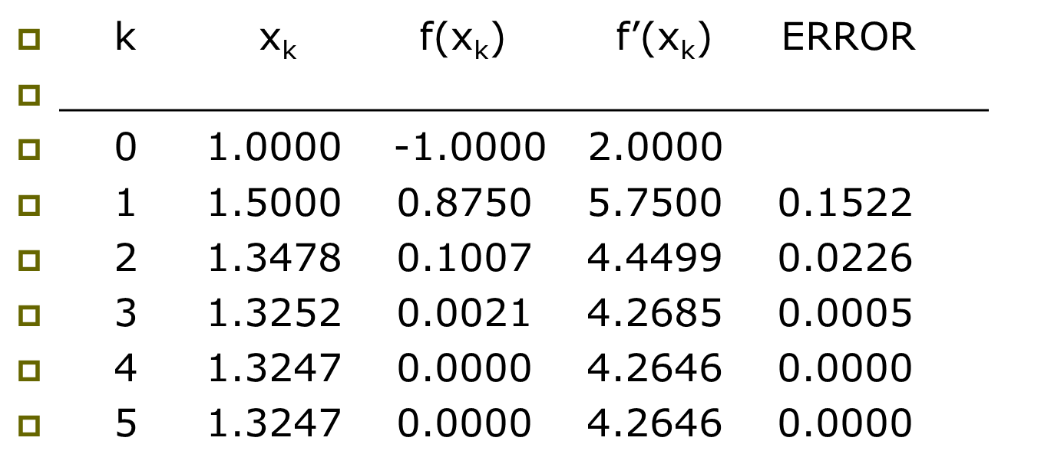
Example

Slide 49
Example

Slide 50
Example

Slide 51
Convergence Analysis Remarks
When the guess is close enough to a simple root of the function, then Newton’s method is guaranteed to converge quadratically.
Quadratic convergence

Slide 52
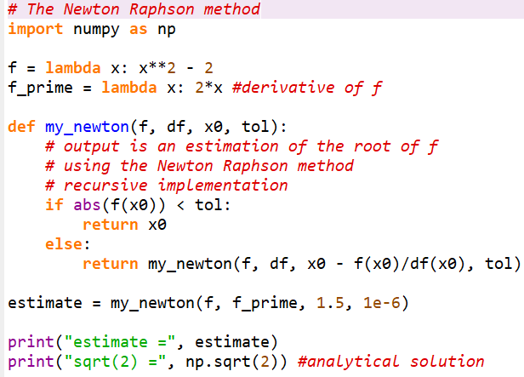

Code
Checks for the root
Function calls itself with the value of next iteration

Slide 53

Problems with Newton’s Method
If the initial guess of the root is far from the root the method may not converge.

Slide 54
Problems with Newton’s Method - Runaway -
x₀
x₁
After 1st iteration
initial guess
The estimates of the root is going away from the root.

Slide 55
Problems with Newton’s Method - Flat Spot -
x₀
The value of f’(x₀) is zero, the algorithm fails.
If f ’(x) is very small then x₁ will be very far from x₀.

Slide 56
Problems with Newton’s Method - Cycle -
x₁=x₃=x₅
x₀=x₂=x₄
initial guess X₀
The algorithm cycles between two values x₀ and x₁

Slide 57
Secant Method

Slide 58
Newton’s Method (Review)

Slide 59

Secant Method
Newton’s Method

Slide 60
Secant Method

Slide 61
Secant Method
initial values

Slide 62
Secant Method - Flowchart
NO
Yes
Stop

Slide 63
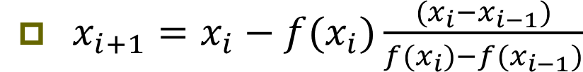
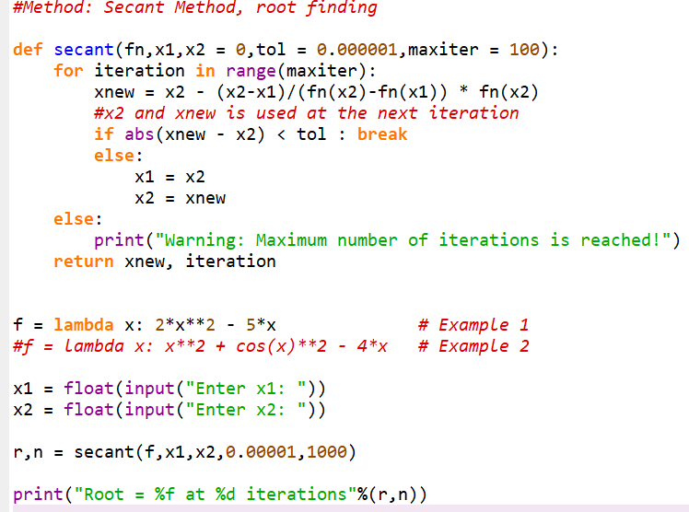

Code
X2 and xnew are used at the next iteration

Slide 64
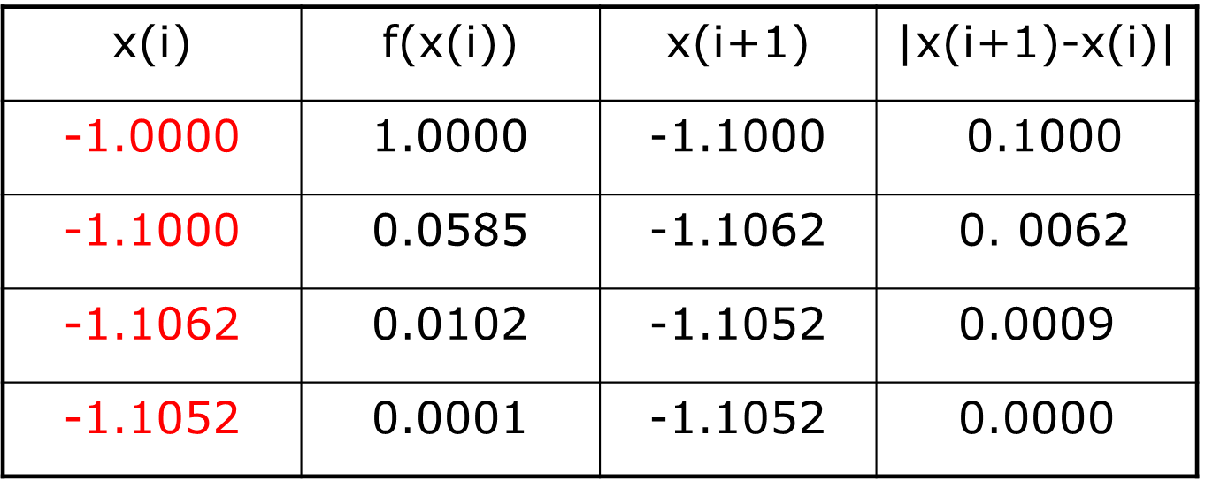
Example

Slide 65

Convergence Analysis
The rate of convergence of the Secant method is super linear:
It is better than Bisection method but not as good as Newton’s method.

Slide 66
Summary
Method | Pros | Cons
Bisection | - Easy, Reliable, Convergent - One function evaluation per iteration - No knowledge of derivative is needed | - Slow - Needs an interval [a,b] containing the root, i.e., f(a)f(b)<0
Newton | - Fast (if near the root) - Two function evaluations per iteration | - May diverge - Needs derivative and an initial guess x0 such that f’(x0) is nonzero
Secant | - Fast (slower than Newton) - One function evaluation per iteration - No knowledge of derivative is needed | - May diverge - Needs two initial points guess x0, x1 such that f(x0)- f(x1) is nonzero

Slide 67
Modified Secant Method

Slide 68
Example
Estimates of the root of: x-cos(x)=0.
0.60000000000000 Initial guess
0.74401731944598 1 correct digit
0.73909047688624 4 correct digits
0.73908513322147 10 correct digits
0.73908513321516 14 correct digits

Slide 69
Example
In estimating the root of: x-cos(x)=0, to get more than 13 correct digits:
4 iterations of Newton (x₀=0.8)
43 iterations of Bisection method (initial
interval [0.6, 0.8])
5 iterations of Secant method
( x₀=0.6, x₁=0.8)

Slide 70
Fixed Point Iteration Stability

Slide 71
Simple Iterations Method
The simple iterations is the simplest method used in finding roots of high-degree equation.
In this method, the equations is rearranged to have the variable on the left side or the equation.
An initial value of the variable, known as initial guess, substituted in the right side and a new value for the variable calculated.
In the second iteration (repeat) the new value substituted on the right side. This cycle will continue until the old value and resulting new value of the variable become, theoretically, equal. Thus, this value will be one of the roots of the equations. Other root can be found with the same manner just by changing the initial guess.

Slide 72
Simple Iterations Method
Now, let’s write solution steps in the following algorithm:
1- Rearrange the equation so that the variable is put on the left side
2- Assume (guess) an initial value of the variable to start the first iteration
3- Substitute the value of the variable in the right side of the equation and calculate an new value for the variable
4- If the new value of the variable is not equal to the previous value, consider the new one as the value of the variable.
5- Repeat steps 3 and 4 until the new value is equal to the old value of the variable.
6- In case the new value does not approach the old value (difference increases at each iteration) stop calculation and try another initial value or another rearrangement of the given equation.

Slide 73
Simple Iterations Method

Slide 74
Simple Iterations Method

Slide 75
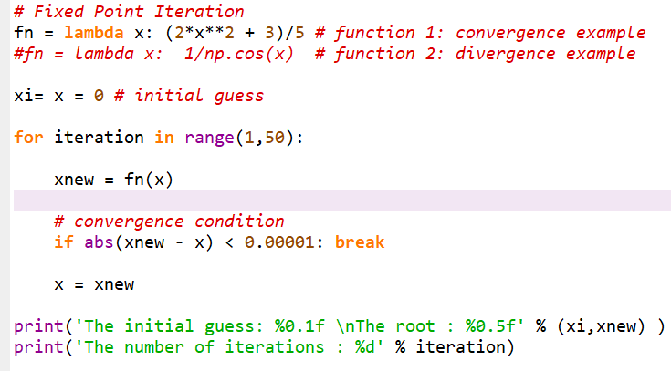


Slide 76

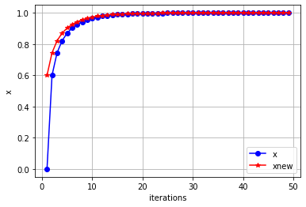
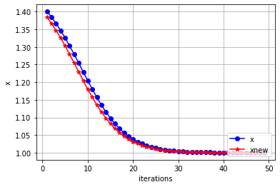


Convergence
The solution obtained for the quadratic equation showed the two values of the variable get closer at each iteration and at the iteration number 50 both values are considered equal when required condition of accuracy was satisfied.
This behavior is known as the convergence of values to a specific solution.
The following graphs show the convergence of the values to 1.

Slide 77
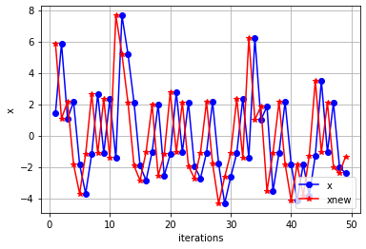
Divergence
The divergence occurs when the difference between the values of the variable gets larger at each iteration until the final value of iterations loop is reached.
The divergence can be resulted from many factors according to the type of the equation, the initial guess and/or method of rearrangement. The following graph shows the behavior of the variables in case of divergence for the equation: xcos(x) – 1 = 0

